Slide 1
20FB6 Malawi Compost Transporter
Team name: The Green Machine
Team member: Husain Aldawood, Connor Schmerfeld, Hope Williams, Shi Zhang

Slide 2
Project Description and Client
The goal is to build a machine that is capable of transporting compost from one place to in a small village in Malawi. It will be a machine that is easy to use and easy to maintain as well.
This project was created in order to help a poor country complete an everyday task much easier.
Client: Dr. McDonnell

Slide 3
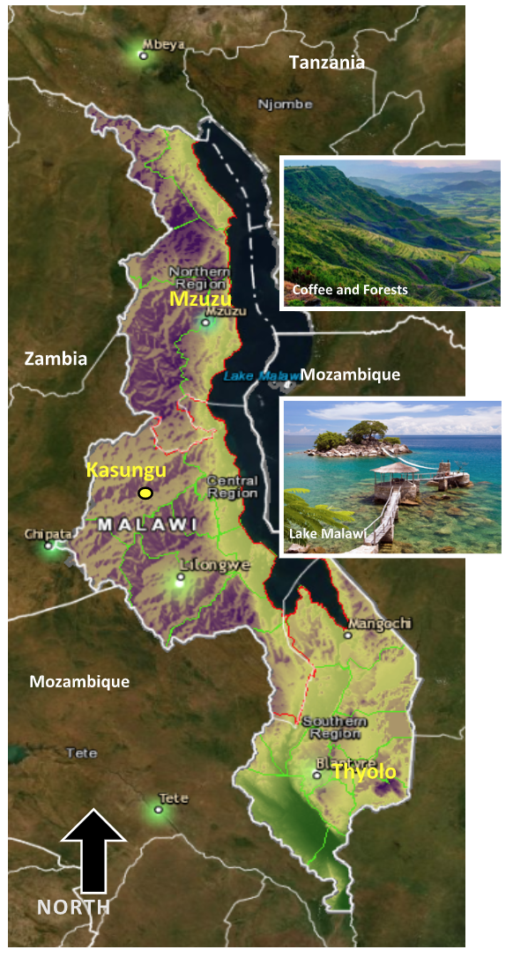
Malawi Background
Malawi is a small landlocked country in the southeastern region of Africa.
It is considered one of the poorest countries in the world.
Most of Malawi’s population engages in subsistence agriculture making waste a major problem.
Currently, women and children are responsible for waste disposal and bringing them to dump sites whereas community members dispose of waste in rivers. [1]
[1]

Slide 4
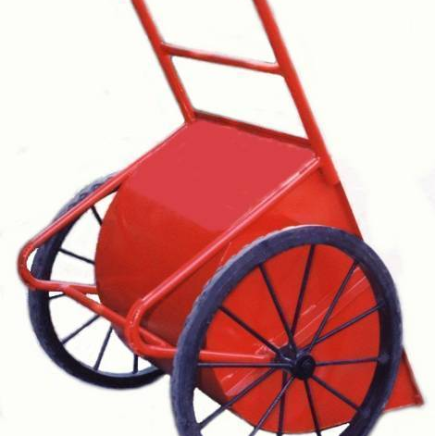
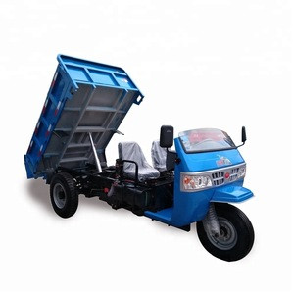
Current State-of-the-Art
[3]
[2]

Slide 5
Customer Needs
Must Have:
Maintainable
Manufacturable
Durable
Lightweight
Easy to Operate
Maneuverable Size
Operable on Muddy Roads
Nice to Have:
Low Cost
Easy to Operate
High Capacity
Rechargeable
Reusable Materials Found in Malawi
Notes:
Maintain: Not alot of parts, easy to repair
Man: further down the line, building multiple
Durable and lightweight and easy to operate: Women, multiple days a week, year round
Maneuverable, muddy roads, rough terrain, rain

Slide 6
Engineering Requirements
Increase Power
Small Dimensions
Increase Waste Capacity
Increase Battery Life
Decrease Weight
Decrease Manufacturing Cost

Slide 7
References
[1] K. M. G. Phiri, K. Ingham, Z. D. Kadzamira, O. J. Kalinga, and J. C. Mitchell, “Malawi,” Encyclopædia Britannica, 06-Feb-2020. [Online]. Available: https://www.britannica.com/place/Malawi#ref43940.
[2] “Trade Wheel,” TradeWheel. [Online]. Available: https://www.tradewheel.com/p/farm-dump-truck-3-wheel-diesel-666378/.
[3] “Concrete Buggy,” www.alibaba.com. [Online]. Available: https://www.alibaba.com/product-detail/Concrete-Buggy_104306347.html.

